Slide 1
Project Proposal Database Management System
Presented BY :
Md. Abdul Rabbi Rahat
213-15-4583
AAM Mustahid
213-15-4251
Anamika Hossain Lily
213-15-4246
Md. Walid Hassan Khan
213-15-4275

Slide 2
Table of Content
Topic | Page
1. Project Idea | 01
2. Features | 02
3. Platform | 03
4. Table | 04
5. ER Diagram | 05

Slide 3

Hospital Management System
PROJECT IDEA : The healthcare industry is continuously evolving, and the need for efficient, automated, and integrated management systems in hospitals is becoming increasingly crucial. The proposed project aims to develop and implement a state of the art “Hospital Management System” to streamline and enhance the overall healthcare management process.

Slide 4




Hospital Management System
Doctor Information Management
Patient Information Management
Appointment Booking Management
Medical Management
History
fEATURES

Slide 5
Platform
Programming language
GRAPHICAL User INterface
DATABASE
PYTHON
TKINTER
MySQL
Insert
update
Operations
delete
truncate

Slide 6
Hospital Management System
Doctor
Patient
Doctor : (DoctorID, Name, Age, Designation)
Patient : (PatientID, FirstName, LastName, Mobile, Email, RoomNumber, Gender, Address, Age, BloodGroup)
Appointment
Medical
Appointment : (ApptID, PatientID, Date, DoctorID)
Medical History : (ApptID, Date , Diagnosis)
Table

Slide 7
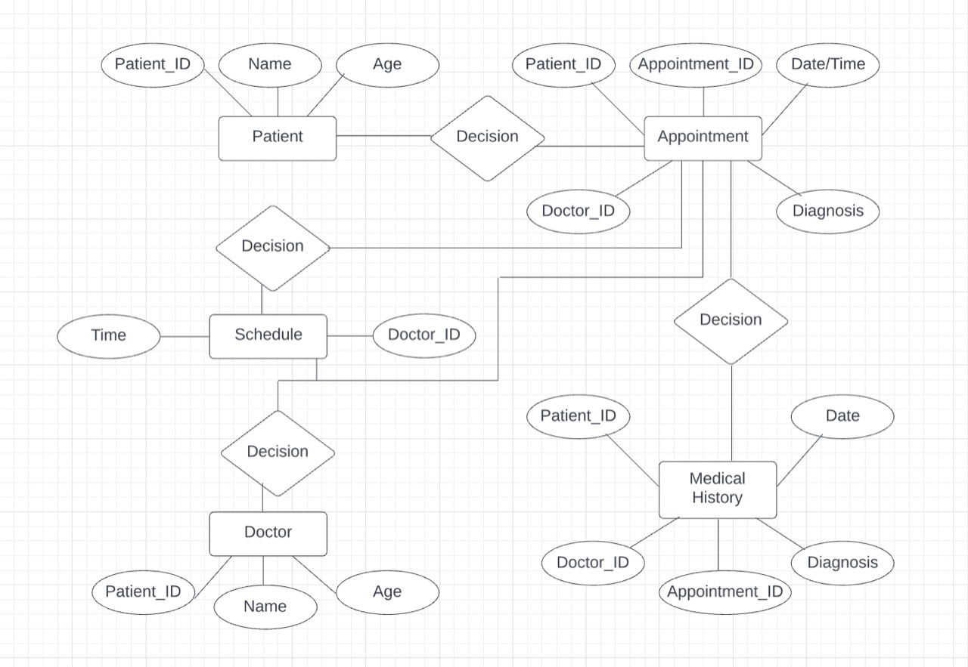
ER DIagram

Slide 8
Thank YOU

